Slide 1
Continuous Difference-in-Differences
Andrew Goodman-Bacon
Senior Economist, Opportunity and Inclusive Growth Institute, Federal Reserve Bank of Minneapolis
August 6, 2024

Slide 2
Big changes for staggered timing…what about continuous treatments?
Variation in treatment intensity/dose/level is:
Common
Often the only variation
Or maybe the “best” variation
3/5 of my DD papers!
Think federal policies!
Think “near vs. far” instead of “shock vs. no shock”

Slide 3

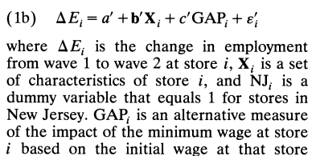
Big changes for staggered timing…what about continuous treatments?
Variation in treatment intensity/dose/level is:
Common
Often the only variation
Or maybe the “best” variation
“Dose-response effects” are:
Evidence for internal validity

Slide 4
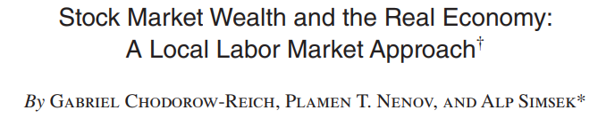
Big changes for staggered timing…what about continuous treatments?
Variation in treatment intensity/dose/level is:
Common
Often the only variation
Or maybe the “best” variation
“Dose-response effects” are:
Evidence for internal validity
Of interest per se

Slide 5
Callaway, Goodman-Bacon, Sant’Anna
Define causal parameters
Average treatment effects (ATT) effect of d vs. 0
Average causal responses (ACRT) effect of d vs. d-1
Identification of “building blocks”
ATT: just like 2x2 DD Parallel Trends – good!
ACRT: need homogeneous effects Strong Parallel Trends – bad?
Two-Period TWFE Estimand
“heterogeneity bias” and weights
Non-parametric estimators

Slide 6
What do you want to know?

Slide 7
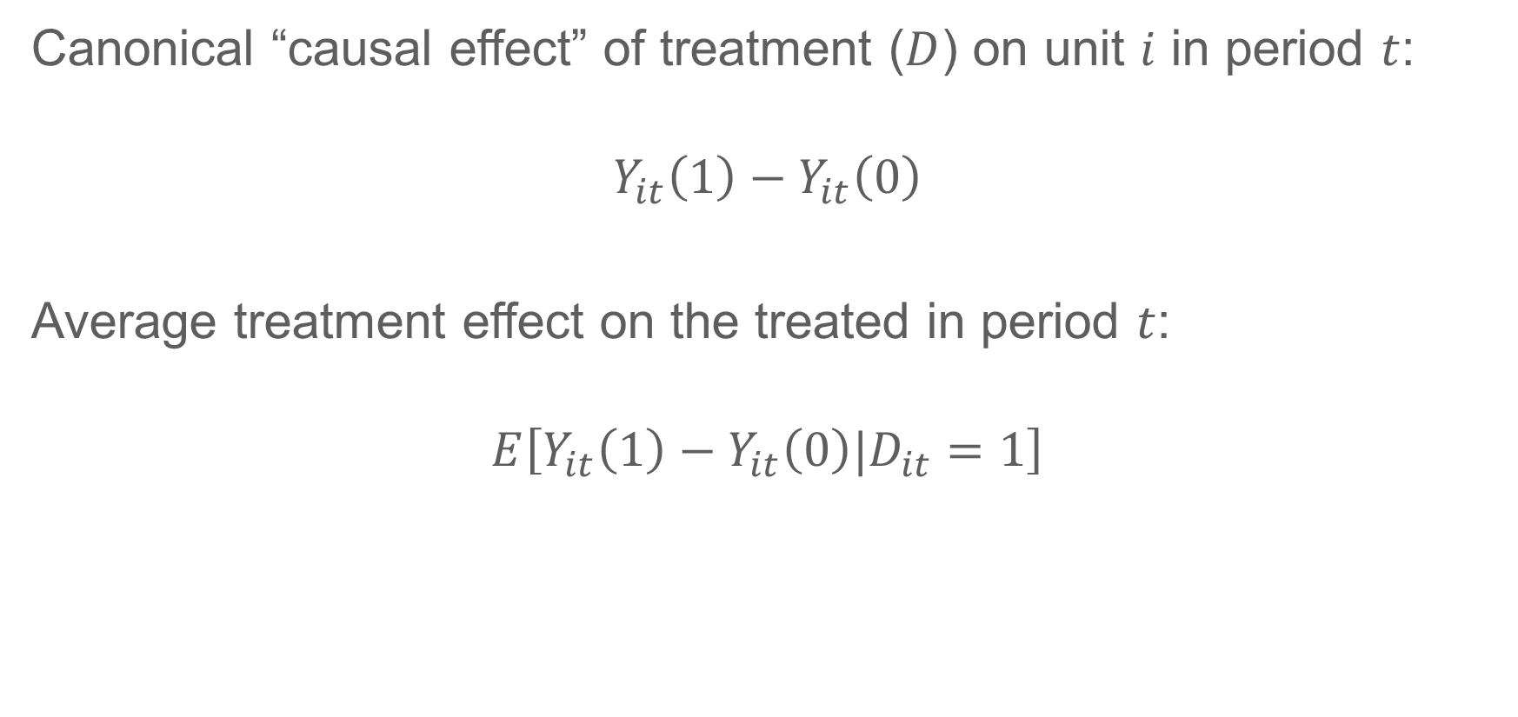
Building Blocks: Levels
Canonical “causal effect” of treatment ($D$) on unit $i$ in period $t$:
$$Y_{it}\left(1\right)−Y_{it}\left(0\right)$$
Average treatment effect on the treated in period $t$:
$$E\left[Y_{it}\left(1\right)−Y_{it}\left(0\right)|D_{it}=1\right]$$

Slide 8
Building Blocks: Levels
Canonical “causal effect” of treatment ($D$) on unit $i$ in period $t$:
$$Y_{it}\left(1\right)−Y_{it}\left(0\right)$$
Average treatment effect on the treated in period $t$:
$$E\left[Y_{it}\left(1\right)−Y_{it}\left(0\right)|D_{it}=1\right]$$

Slide 9
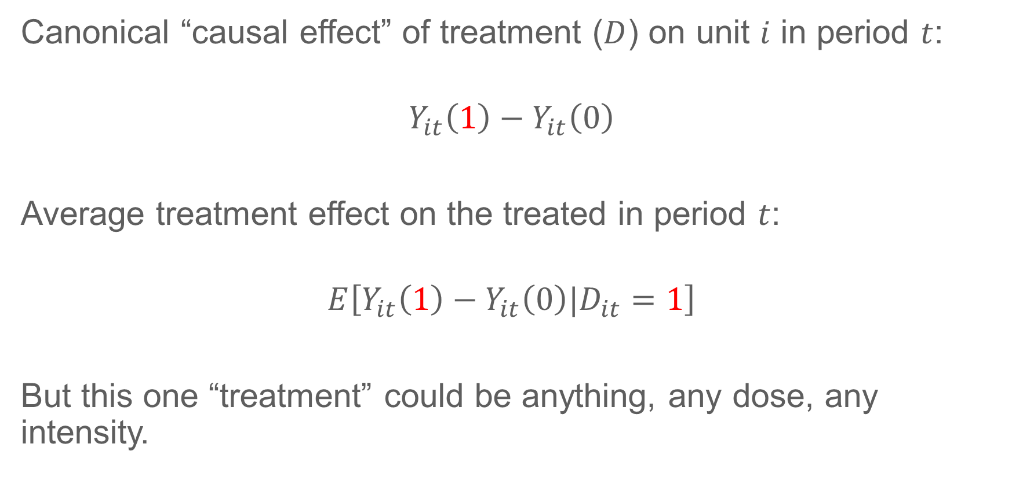
Building Blocks: Levels
Canonical “causal effect” of treatment ($D$) on unit $i$ in period $t$:
$$Y_{it}\left(1\right)−Y_{it}\left(0\right)$$
Average treatment effect on the treated in period $t$:
$$E\left[Y_{it}\left(1\right)−Y_{it}\left(0\right)|D_{it}=1\right]$$
But this one “treatment” could be anything, any dose, any intensity.

Slide 10
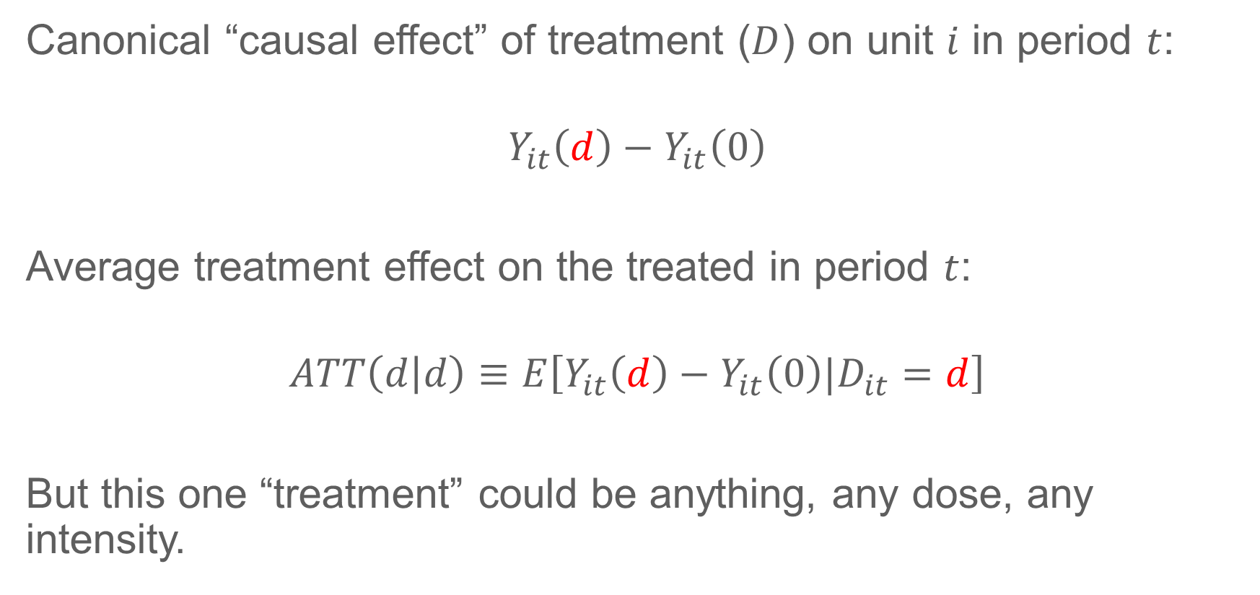
Building Blocks: Levels
Canonical “causal effect” of treatment ($D$) on unit $i$ in period $t$:
$$Y_{it}\left(d\right)−Y_{it}\left(0\right)$$
Average treatment effect on the treated in period $t$:
$$ATT\left(d | d\right)≡E\left[Y_{it}\left(d\right)−Y_{it}\left(0\right)|D_{it}=d\right]$$
But this one “treatment” could be anything, any dose, any intensity.

Slide 11
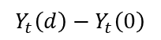
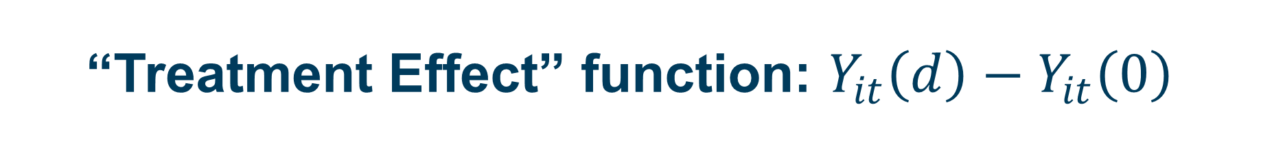
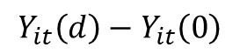
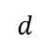
“Treatment Effect” function: $Y_{it}\left(d\right)−Y_{it}\left(0\right)$
$$Y_{t}\left(d\right)−Y_{t}\left(0\right)$$
The effect of aspirin dosage on my pain relief
$$Y_{it}\left(d\right)−Y_{it}\left(0\right)$$
$$d$$

Slide 12
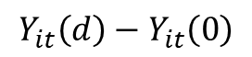
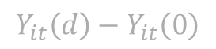
“Treatment Effect” function: $Y_{it}\left(d\right)−Y_{it}\left(0\right)$
$$Y_{t}\left(d\right)−Y_{t}\left(0\right)$$
The effect of aspirin dosage on your pain relief
$$Y_{it}\left(d\right)−Y_{it}\left(0\right)$$
The effect of aspirin dosage on my pain relief
$$Y_{it}\left(d\right)−Y_{it}\left(0\right)$$
$$d$$

Slide 13
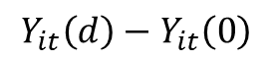
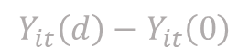
“Treatment Effect” function: $Y_{it}\left(d\right)−Y_{it}\left(0\right)$
$$Y_{t}\left(d\right)−Y_{t}\left(0\right)$$
The effect of aspirin dosage on your pain relief
$$Y_{it}\left(d\right)−Y_{it}\left(0\right)$$
The effect of aspirin dosage on my pain relief
$$Y_{it}\left(d\right)−Y_{it}\left(0\right)$$
The effect of aspirin dosage on
some other guy’s pain relief
$$Y_{it}\left(d\right)−Y_{it}\left(0\right)$$
$$d$$

Slide 14
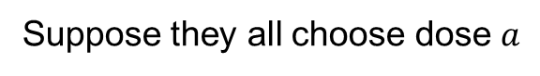
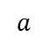
“Treatment Effect” function: $Y_{it}\left(d\right)−Y_{it}\left(0\right)$
$$Y_{t}\left(d\right)−Y_{t}\left(0\right)$$
Suppose they all choose dose $a$
$$d$$
$$a$$

Slide 15
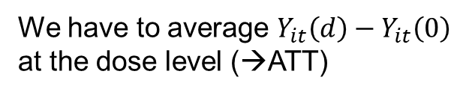
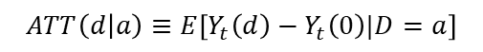
“Treatment Effect” function: $Y_{it}\left(d\right)−Y_{it}\left(0\right)$
$$Y_{t}\left(d\right)−Y_{t}\left(0\right)$$
We have to average $Y_{it}\left(d\right)−Y_{it}\left(0\right)$
at the dose level (→ATT)
Suppose they all choose dose $a$
$$ATT\left(d | a\right)≡E\left[Y_{t}\left(d\right)−Y_{t}\left(0\right)|D=a\right]$$
$$d$$
$$a$$

Slide 16
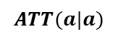
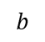
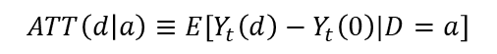
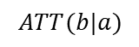
Average Treatment Effects on the Treated: ATT(d|d)
$$Y_{t}\left(d\right)−Y_{t}\left(0\right)$$
What is the effect of 3 aspirin on the
headache of people who actually took 2?
$$ATT\left(d | a\right)≡E\left[Y_{t}\left(d\right)−Y_{t}\left(0\right)|D=a\right]$$
$$ATT(b|a)$$
$$ATT(a|a)$$
$$d$$
$$a$$
$$b$$

Slide 17
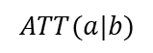
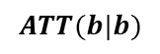
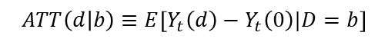
Average Treatment Effects on the Treated: ATT(d|d)
$$Y_{t}\left(d\right)−Y_{t}\left(0\right)$$
What is the effect of 2 aspirin on the headache of people who actually took 3?
$$ATT\left(d | b\right)≡E\left[Y_{t}\left(d\right)−Y_{t}\left(0\right)|D=b\right]$$
$$ATT(b|b)$$
$$ATT(a|b)$$
$$ATT\left(d | a\right)≡E\left[Y_{t}\left(d\right)−Y_{t}\left(0\right)|D=a\right]$$
$$ATT(b|a)$$
$$ATT(a|a)$$
$$d$$
$$a$$
$$b$$

Slide 18
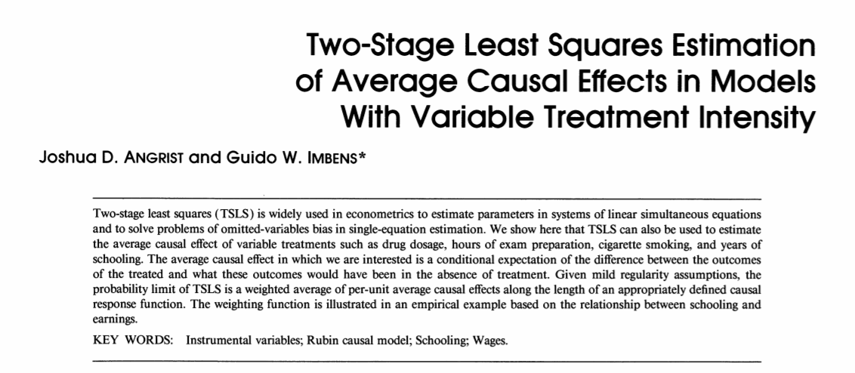
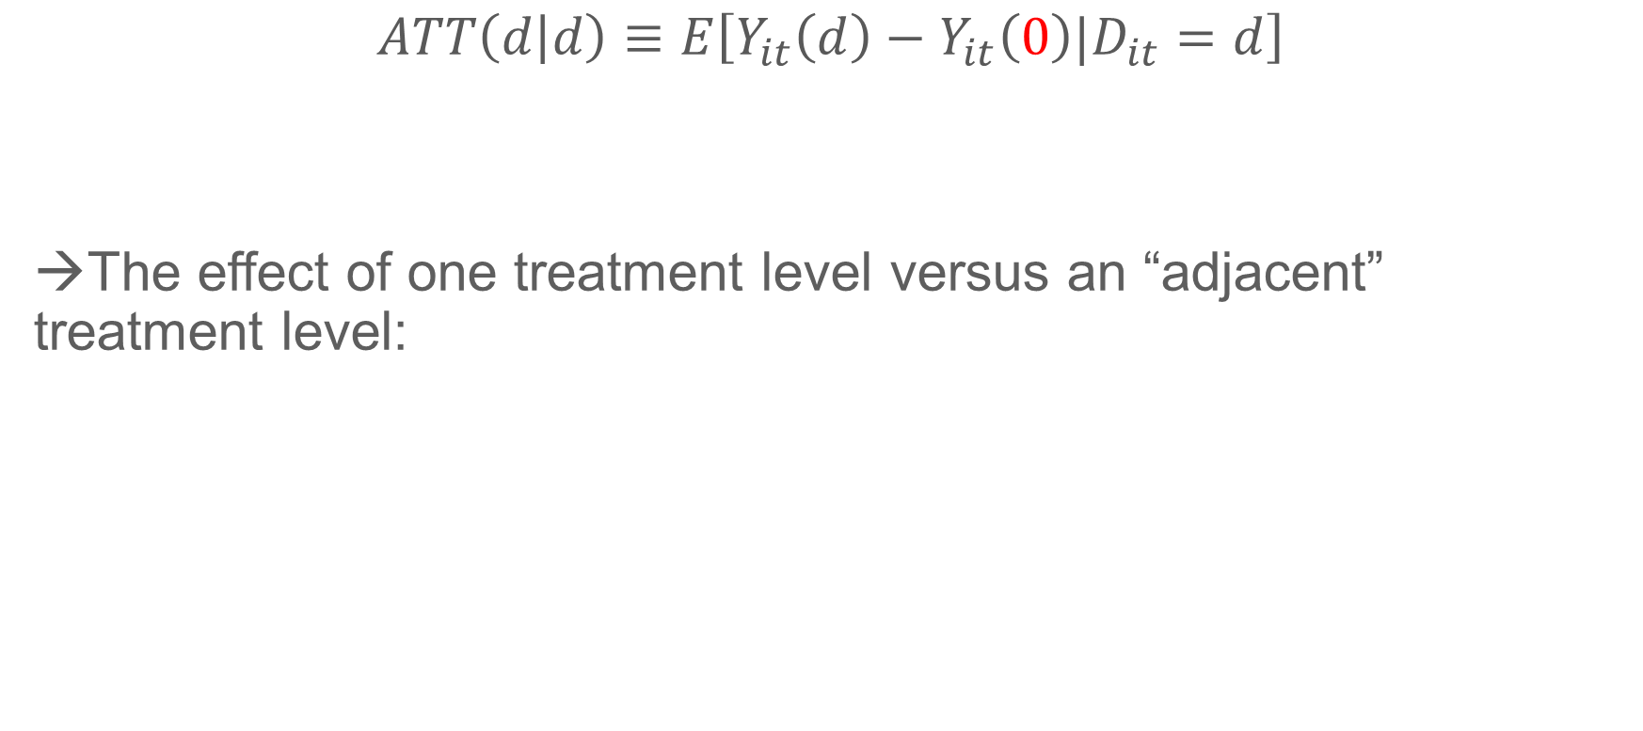
Building Blocks: Slopes
$$ATT\left(d | d\right)≡E\left[Y_{it}\left(d\right)−Y_{it}\left(0\right)|D_{it}=d\right]$$
→The effect of one treatment level versus an “adjacent” treatment level:
No treatment is not the only counterfactual!

Slide 19
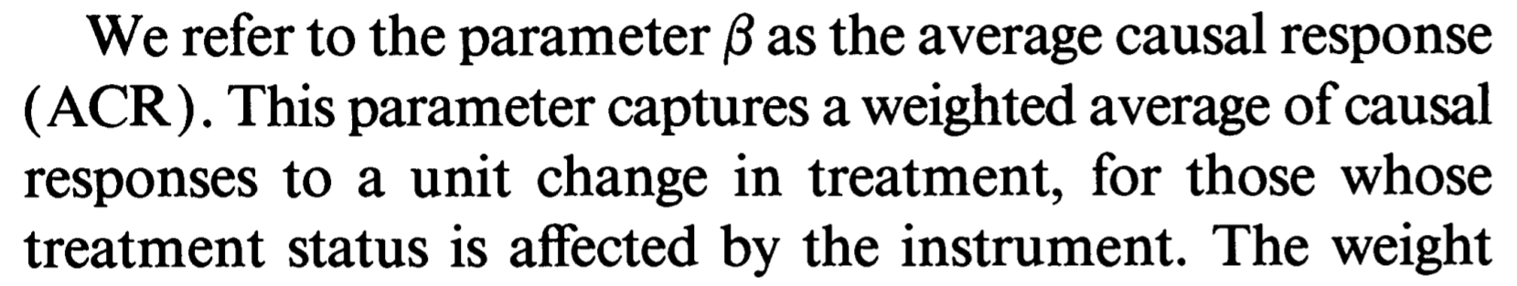
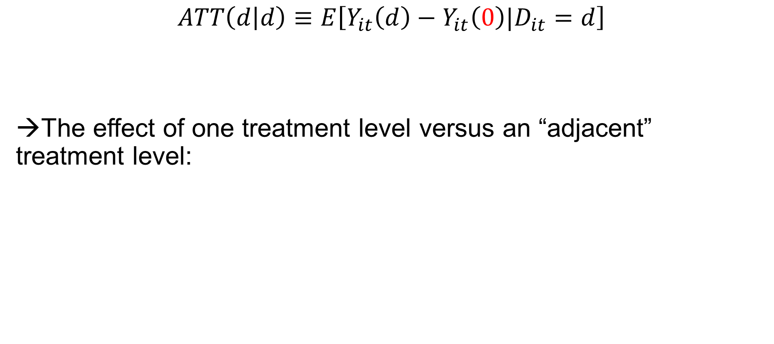
Building Blocks: Slopes
$$ATT\left(d | d\right)≡E\left[Y_{it}\left(d\right)−Y_{it}\left(0\right)|D_{it}=d\right]$$
→The effect of one treatment level versus an “adjacent” treatment level:
No treatment is not the only counterfactual!

Slide 20
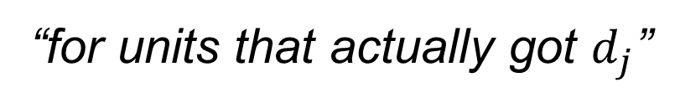
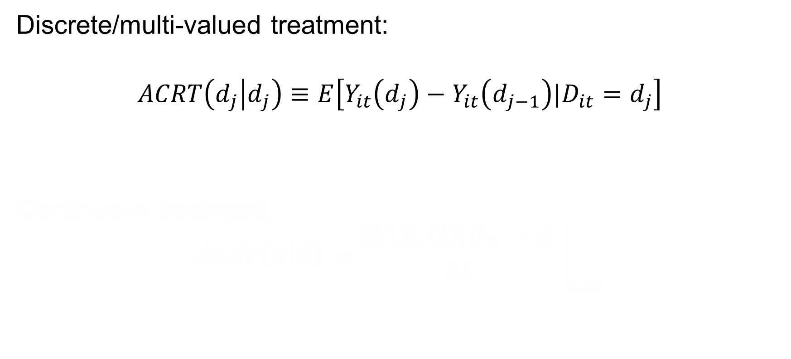
Building Blocks: Slopes
Discrete/multi-valued treatment:
$$ACRT\left(d_{j} | d_{j}\right)≡E\left[Y_{it}\left(d_{j}\right)−Y_{it}\left(d_{j−1}\right)|D_{it}=d_{j}\right]$$
Continuous treatment:
$$ACRT\left(d | d\right)≡{\left.\frac{∂E\left[Y_{it}\left(l\right)|D_{it}=d\right]}{∂l}\right|}_{l=d}$$
“for units that actually got $d_{j}$”
“the causal effect of the j^{th} dose increment for unit i”

Slide 21
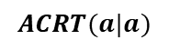
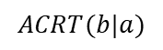

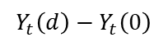
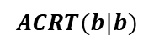
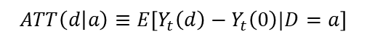
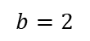
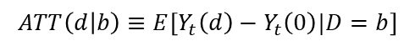
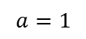
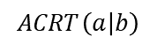
Average Causal Responses on the Treated, Discrete: $ACRT(d_{j}|d_{j})$
$$Y_{t}\left(d\right)−Y_{t}\left(0\right)$$
$$ATT\left(d | b\right)≡E\left[Y_{t}\left(d\right)−Y_{t}\left(0\right)|D=b\right]$$
$$ACRT(b|b)$$
$$ACRT\left(a | b\right)$$
$$ATT\left(d | a\right)≡E\left[Y_{t}\left(d\right)−Y_{t}\left(0\right)|D=a\right]$$
$$ACRT(b|a)$$
$$ACRT(a|a)$$
$$d$$
$$a=1$$
$$b=2$$

Slide 22

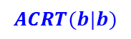
Average Causal Responses on the Treated, Discrete: $ACRT(d_{j}|d_{j})$
$$Y_{t}\left(d\right)−Y_{t}\left(0\right)$$
What is the effect of the 2nd aspirin on the headache of people who actually took 2?
$$ATT\left(d | b\right)≡E\left[Y_{t}\left(d\right)−Y_{t}\left(0\right)|D=b\right]$$
$$ACRT(b|b)$$
$$ACRT\left(a | b\right)$$
$$ATT\left(d | a\right)≡E\left[Y_{t}\left(d\right)−Y_{t}\left(0\right)|D=a\right]$$
$$ACRT(b|a)$$
$$ACRT(a|a)$$
$$d$$
$$a=1$$
$$b=2$$

Slide 23
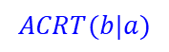
Average Causal Responses on the Treated, Discrete: $ACRT(d_{j}|d_{j})$
$$Y_{t}\left(d\right)−Y_{t}\left(0\right)$$
What is the effect of the 2nd aspirin on the headache of people who actually took 1?
$$ATT\left(d | b\right)≡E\left[Y_{t}\left(d\right)−Y_{t}\left(0\right)|D=b\right]$$
$$ACRT(b|b)$$
$$ACRT\left(a | b\right)$$
$$ATT\left(d | a\right)≡E\left[Y_{t}\left(d\right)−Y_{t}\left(0\right)|D=a\right]$$
$$ACRT(b|a)$$
$$ACRT(a|a)$$
$$d$$
$$a=1$$
$$b=2$$

Slide 24
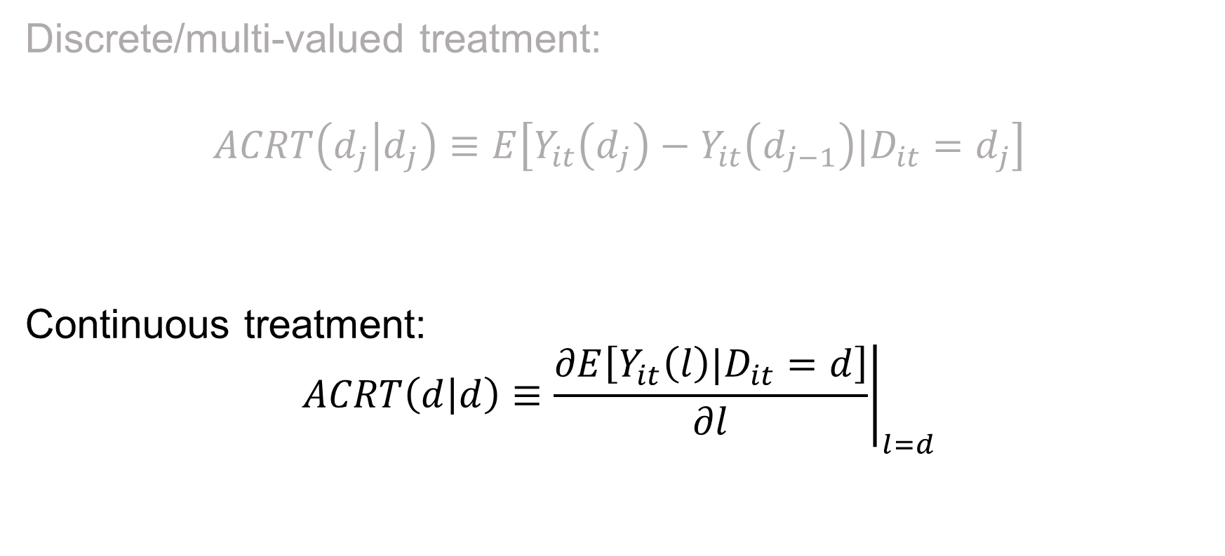
Building Blocks: ACRTs
Discrete/multi-valued treatment:
$$ACRT\left(d_{j} | d_{j}\right)≡E\left[Y_{it}\left(d_{j}\right)−Y_{it}\left(d_{j−1}\right)|D_{it}=d_{j}\right]$$
Continuous treatment:
$$ACRT\left(d | d\right)≡{\left.\frac{∂E\left[Y_{it}\left(l\right)|D_{it}=d\right]}{∂l}\right|}_{l=d}$$

Slide 25
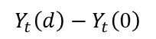
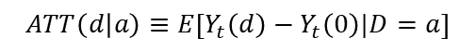
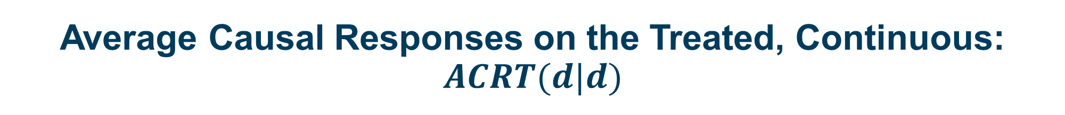
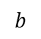
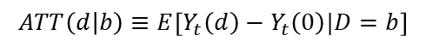
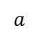
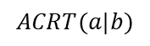
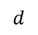

Average Causal Responses on the Treated, Continuous: $ACRT(d|d)$
$$Y_{t}\left(d\right)−Y_{t}\left(0\right)$$
$$ACRT(b|b)$$
$$ATT\left(d | b\right)≡E\left[Y_{t}\left(d\right)−Y_{t}\left(0\right)|D=b\right]$$
$$ACRT(a|b)$$
$$ACRT(b|a)$$
$$ACRT(a|a)$$
$$ATT\left(d | a\right)≡E\left[Y_{t}\left(d\right)−Y_{t}\left(0\right)|D=a\right]$$
$$d$$
$$a$$
$$b$$

Slide 26
Comment 1: This is a lot of causal parameters
Potential Treatment:
Treated
ATT
ATU
Treated
With 2x2 DiD (and no conditioning on X), there are…2 average parameters
Actual Treatment:
Untreated

Slide 27






































Comment 1: This is a lot of causal parameters
Potential Treatment:
$$d_{1}$$
$$d_{2}$$
$$d_{3}$$
$$…$$
$$d_{J−1}$$
$$d_{J}$$
$$d_{1}$$
$$ATT(d_{1}|d_{1})$$
$$ATT(d_{2}|d_{1})$$
$$ATT(d_{3}|d_{1})$$
$$ATT(d_{J−1}|d_{1})$$
$$ATT(d_{J}|d_{1})$$
$$d_{2}$$
$$ATT(d_{1}|d_{2})$$
$$ATT(d_{2}|d_{2})$$
$$ATT(d_{3}|d_{2})$$
$$ATT(d_{J−1}|d_{2})$$
$$ATT(d_{J}|d_{2})$$
Actual Treatment:
$$d_{3}$$
$$ATT(d_{1}|d_{3})$$
$$ATT(d_{2}|d_{3})$$
$$ATT(d_{3}|d_{3})$$
$$ATT(d_{J−1}|d_{3})$$
$$ATT(d_{J}|d_{3})$$
$$⋮$$
$$⋱$$
$$d_{J−1}$$
$$ATT(d_{1}|d_{J−1})$$
$$ATT(d_{2}|d_{J−1})$$
$$ATT(d_{3}|d_{J−1})$$
$$ATT(d_{J−1}|d_{J−1})$$
$$ATT(d_{J}|d_{J−1})$$
$$d_{J}$$
$$ATT(d_{1}|d_{J})$$
$$ATT(d_{2}|d_{J})$$
$$ATT(d_{3}|d_{J})$$
$$ATT(d_{J−1}|d_{J})$$
$$ATT(d_{J}|d_{J})$$

Slide 28






















































Comment 1: This is a lot of causal parameters
Potential Treatment:
$$d_{1}$$
$$d_{2}$$
$$d_{3}$$
$$…$$
$$d_{J−1}$$
$$d_{J}$$
$$ACRT(d_{2}|d_{1})$$
$$ACRT(d_{3}|d_{1})$$
$$ACRT(d_{J}|d_{1})$$
$$d_{1}$$
$$ATT(d_{1}|d_{1})$$
$$ATT(d_{2}|d_{1})$$
$$ATT(d_{3}|d_{1})$$
$$ATT(d_{J−1}|d_{1})$$
$$ATT(d_{J}|d_{1})$$
$$ACRT(d_{2}|d_{2})$$
$$ACRT(d_{3}|d_{2})$$
$$ACRT(d_{J}|d_{2})$$
$$d_{2}$$
$$ATT(d_{1}|d_{2})$$
$$ATT(d_{2}|d_{2})$$
$$ATT(d_{3}|d_{2})$$
$$ATT(d_{J−1}|d_{2})$$
$$ATT(d_{J}|d_{2})$$
$$ACRT(d_{J}|d_{3})$$
And if $D$ is continuous these are functions!
$$ACRT(d_{2}|d_{3})$$
$$ACRT(d_{3}|d_{3})$$
Actual Treatment:
$$d_{3}$$
$$ATT(d_{1}|d_{3})$$
$$ATT(d_{2}|d_{3})$$
$$ATT(d_{3}|d_{3})$$
$$ATT(d_{J−1}|d_{3})$$
$$ATT(d_{J}|d_{3})$$
$$⋮$$
$$⋱$$
$$ACRT(d_{2}|d_{J−1})$$
$$ACRT(d_{3}|d_{J−1})$$
$$ACRT(d_{J}|d_{J−1})$$
$$d_{J−1}$$
$$ATT(d_{1}|d_{J−1})$$
$$ATT(d_{2}|d_{J−1})$$
$$ATT(d_{3}|d_{J−1})$$
$$ATT(d_{J−1}|d_{J−1})$$
$$ATT(d_{J}|d_{J−1})$$
$$ACRT(d_{2}|d_{J})$$
$$ACRT(d_{3}|d_{J})$$
$$ACRT(d_{J}|d_{J})$$
$$d_{J}$$
$$ATT(d_{1}|d_{J})$$
$$ATT(d_{2}|d_{J})$$
$$ATT(d_{3}|d_{J})$$
$$ATT(d_{J−1}|d_{J})$$
$$ATT(d_{J}|d_{J})$$

Slide 29




Comment 2: The distinction matters!
$$Y_{t}\left(d\right)−Y_{t}\left(0\right)$$
$$ACR\left(b | b\right)=ACR\left(b\right)<0$$
$$ATE\left(b\right)>0$$
$$ATE(d)$$
$$d$$
$$b$$

Slide 30
What are you willing to believe?

Slide 31

Parallel Trends
For all $d∈𝒟$:
$$E\left[Y_{it}\left(0\right)−Y_{it−1}\left(0\right)\right]=E\left[Y_{it}\left(0\right)−Y_{it−1}\left(0\right)|D_{i}=d\right]$$
Extension of binary parallel trends (when $D∈\{0,1\}$).

Slide 32

Identifying ATT
This is just like traditional 2x2 DD
$E\left[ΔY_{it}|D_{i}=d\right]−E\left[ΔY_{it}|D_{i}=0\right]$
$$=E\left[Y_{it}\left(d\right)−Y_{it−1}\left(0\right)|D_{i}=d\right]−E\left[Y_{it}\left(0\right)−Y_{it−1}\left(0\right)|D_{i}=0\right]$$
$$=E\left[Y_{it}\left(d\right)−Y_{it}\left(0\right)|D_{i}=d\right]+$$
$$E\left[Y_{it}\left(0\right)−Y_{it−1}\left(0\right)|D_{i}=0\right]−E\left[Y_{it}\left(0\right)−Y_{it−1}\left(0\right)|D_{i}=0\right]$$
No Ant.

Slide 33

Identifying ATT
This is just like traditional 2x2 DD
$E\left[ΔY_{it}|D_{i}=d\right]−E\left[ΔY_{it}|D_{i}=0\right]$
$$=E\left[Y_{it}\left(d\right)−Y_{it−1}\left(0\right)|D_{i}=d\right]−E\left[Y_{it}\left(0\right)−Y_{it−1}\left(0\right)|D_{i}=0\right]$$
$$=E\left[Y_{it}\left(d\right)−Y_{it}\left(0\right)|D_{i}=d\right]+$$
$$E\left[Y_{it}\left(0\right)−Y_{it−1}\left(0\right)|D_{i}=0\right]−E\left[Y_{it}\left(0\right)−Y_{it−1}\left(0\right)|D_{i}=0\right]$$
$$=ATT\left(d | d\right)$$
No Ant.
PT

Slide 34


Identifying $ATT^{o}$
$$ATT^{o}≡E\left[ATT\left(D | D\right) | D>0\right]$$
$=E\left[E\left[ΔY_{it}|D=d\right]−E\left[ΔY_{it}|D=0\right]|D>0\right]$
$$=E\left[E\left[ΔY_{it}|D=d\right]|D>0\right]−E\left[E\left[ΔY_{it}|D=0\right] | D>0\right]$$
$$=E\left[ΔY_{it}|D>0\right]−E\left[ΔY_{it}|D=0\right]$$
If you want an average ATT then
don’t use the dose variation at all

Slide 35

Identifying ACRT
$ATT\left(d_{j} | d_{j}\right)−ATT\left(d_{j−1} | d_{j−1}\right)$
$$=\left(ATT\left(d_{j} | d_{j}\right)−ATT\left(d_{j−1} | d_{j}\right)\right)+\left(ATT\left(d_{j−1} | d_{j}\right)−ATT\left(d_{j−1} | d_{j−1}\right)\right)$$
$$=ACRT\left(d_{j} | d_{j}\right)+\left(ATT\left(d_{j−1} | d_{j}\right)−ATT\left(d_{j−1} | d_{j−1}\right)\right)$$
(No Ant. + PT)
Interpretable causal effect
“Selection bias” (heterogeneous effects at $d_{j−1}$)

Slide 36





Identifying ACRT
$$Y_{t}\left(d\right)−Y_{t}\left(0\right)$$
$$ATT\left(d | b\right)≡E\left[Y_{t}\left(d\right)−Y_{t}\left(0\right)|D=b\right]$$
$$ATT(b|b)$$
$$ACRT(b|b)$$
$$ATT(a|b)$$
$$ATT\left(d | a\right)≡E\left[Y_{t}\left(d\right)−Y_{t}\left(0\right)|D=a\right]$$
bias
$$ATT(a|a)$$
$$d$$
$$a=1$$
$$b=2$$

Slide 37
Identifying ACRT
$$Y_{t}\left(d\right)−Y_{t}\left(0\right)$$
$$ATT\left(d | b\right)≡E\left[Y_{t}\left(d\right)−Y_{t}\left(0\right)|D=b\right]$$
$$ATT(b|b)$$
$$ACRT(b|b)$$
This is the counterfactual we need
$$ATT(a|b)$$
$$ATT\left(d | a\right)≡E\left[Y_{t}\left(d\right)−Y_{t}\left(0\right)|D=a\right]$$
bias
$$ATT(a|a)$$
But this is the one we get from the lower-dose units
$$d$$
$$a=1$$
$$b=2$$

Slide 38

Strong Parallel Trends
PT + homogenous treatment effect functions:
$$E\left[Y_{it}\left(0\right)−Y_{it−1}\left(0\right)\right]=E\left[Y_{it}\left(0\right)−Y_{it−1}\left(0\right)|D_{i}=d\right] ∀ d$$
+
$$ATT\left(d | d\right)=ATT\left(d | d^{′}\right) ∀ d, d^{′}$$
Groups don’t change differentially
for non-treatment-related reasons
Nor do they change for treatment
effect reasons at a given dose

Slide 39

We (almost) never say this
*also Saez, Slemrod, Giertz 2012 JEL.

Slide 40





Identifying ACR under SPT: “same curve”
$$Y_{t}\left(d\right)−Y_{t}\left(0\right)$$
Good:
Identifies $ACR(d)$ and $ATE(d)$
(…not $ATT(d|d)$and $ACRT(d|d)$!)
Bad:
We were never willing to assume
SPT in binary designs—too strong!
inching closer to IV independence
assumption/quasi-randomness
$$ATE(d)$$
$$ATE(b|b)$$
$$ACR (b|b)$$
$$ATE(a|a)$$
$$d$$
$$a=1$$
$$b=2$$

Slide 41
TWFE: 2 Periods

Slide 42

Acemoglu and Finkelstein (2008)
Medicare prospective payment system (PPS; 1984) lowered the relative price of capital moreso for hospitals with more Medicare patients. What happens to K/L?
$$Y_{it}=α_{i}+α_{t}+{\hat{β}}^{TWFE}D_{i}×POST_{t}+u_{it}$$
$D_{i}=$ pre-PPS Medicare share of inpatient days
1.13 ← it goes up!

Slide 43

Acemoglu and Finkelstein (2008)
Medicare prospective payment system (PPS; 1984) lowered the relative price of capital moreso for hospitals with more Medicare patients. What happens to K/L?
$$ΔY_{it}={\hat{β}}^{TWFE}D_{i}+{Δu}_{it}$$
$D_{i}=$ pre-PPS Medicare share of inpatient days
1.13

Slide 44

Acemoglu and Finkelstein (2008)
1.13

Slide 45


A simple scatter plot
Binscatter of $ΔK_{i}/L_{i}$ against $D_{i}$
${\hat{β}}^{TWFE}$ = 1.13
How to interpret 1.13?
ACR vs ATT?
Under PT vs SPT?
Aggregation?

Slide 46



A simple scatter plot
Yitzhaki (1996):
${\hat{β}}^{TWFE}$ = weighted average
of adjacent slopes
${\hat{β}}^{TWFE}$ = 1.13 (0.35)
“Wald DDs”
$$\frac{E\left[ΔY_{t} | D=d_{j}\right]−E\left[ΔY_{t} | D=d_{j−1}\right]}{d_{j}−d_{j−1}}$$

Slide 47

Two-way fixed effects, discrete (ACR)
$${\hat{β}}^{TWFE}=\sum_{d_{j}∈𝒟_{+}}{w^{acr}\left(d_{j}\right)\frac{E\left[ΔY_{t} | D=d_{j}\right]−E\left[ΔY_{t} | D=d_{j−1}\right]}{d_{j}−d_{j−1}}}$$
Where:
$$w^{acr}\left(d_{j}\right)=\frac{\left(E\left[D|D>d_{j}\right]−E\left[D\right]\right)P\left(D>d_{j}\right)}{V(D)}$$
And $w^{acr}\left(d_{j}\right)≥0$and $\sum_{d_{j}∈𝒟_{+}}{w^{acr}\left(d_{j}\right)}=1$.
and that are hump-shaped
and centered on E[D]
Weights are non-negative and sum to one.

Slide 48

How should we interpret 1.13?*
$$1.13=\sum_{d_{j}∈𝒟_{+}}{w^{acr}\left(d_{j}\right)\left[ACRT\left(d_{j} | d_{j}\right)+\left(ATT\left(d_{j−1} | d_{j}\right)−ATT(d_{j−1}|d_{j−1})\right)\right]}$$
$$=\sum_{d_{j}∈𝒟_{+}}{w^{acr}\left(d_{j}\right)ACRT\left(d_{j} | d_{j}\right)}+\sum_{d_{j}∈𝒟_{+}}{w^{acr}\left(d_{j}\right)\left(ATT\left(d_{j−1} | d_{j}\right)−ATT(d_{j−1}|d_{j−1})\right)}$$
*Under PT and in terms of ACRT parameters.

Slide 49

How should we interpret 1.13?*
$$1.13=\sum_{d_{j}∈𝒟_{+}}{w^{acr}\left(d_{j}\right)\left[ACRT\left(d_{j} | d_{j}\right)+\left(ATT\left(d_{j−1} | d_{j}\right)−ATT(d_{j−1}|d_{j−1})\right)\right]}$$
$$=\sum_{d_{j}∈𝒟_{+}}{w^{acr}\left(d_{j}\right)ACRT\left(d_{j} | d_{j}\right)}+\sum_{d_{j}∈𝒟_{+}}{w^{acr}\left(d_{j}\right)\left(ATT\left(d_{j−1} | d_{j}\right)−ATT(d_{j−1}|d_{j−1})\right)}$$
Problem 1:
combines a “weakly” causal parameter with treatment effect heterogeneity.
*Under PT and in terms of ACRT parameters.

Slide 50
Without SPT, each ACRT is biased

Slide 51
With SPT, $w^{acr}\left(d_{j}\right)$-weighted average of ACR(d)
This is the ATE(d) function
${\hat{β}}^{TWFE}$ = 1.13 (0.35)
These are all ACRs and there is a real hump-shape response…
(which is not consistent with the 2-factor production theory!)

Slide 52

Not enough weight up here (where slopes are flat!)
If we just change the weighting, the summary ACR parameter falls to 0.8!
Too much weight down here (where slopes are steep!)

Slide 53






The simple scatter plot again
Binscatter of $ΔK_{i}/L_{i}$ against $D_{i}$
OLS = 1.13 (0.35)
Does OLS have a sensible interpretation under PT in terms of $ATT(d|d)$s?
$$ATT(0.06|0.06)$$
$$ATT(0.4|0.4)$$
$$ATT(0.72|0.72)$$
$$Y_{t}\left(0\right)−Y_{t−1}\left(0\right)$$

Slide 54

Two-way fixed effects, discrete (ATT)
$$β^{TWFE}=\sum_{d_{j}∈𝒟_{+}}{w^{att}\left(d_{j}\right)\left[E\left[ΔY_{t} | D=d_{j}\right]−E\left[ΔY_{t} | D=0\right]\right]}$$
Where:
$$w^{att}\left(d_{j}\right)=\frac{\left(d_{j}−E\left[D\right]\right)P\left(D=d_{j}\right)}{V(D)}$$
And $w^{att}\left(d_{j}\right)>0 if d_{j}>E[D\}$and $\sum_{d_{j}∈𝒟_{+}}{w^{att}\left(d_{j}\right)}=0$.
Equal zero at E[D],
Over-weight extreme doses
Weights are negative for below
average doses and sum to zero.

Slide 55
Much more weight on high doses relative to their share.
Negative weights down here.

Slide 56

TWFE binarizes and rescales
$$1.13=\frac{E\left[w_{1}^{bin}\left(D\right)ΔY|D>E[D]\right]−E\left[w_{0}^{bin}\left(D\right)ΔY|D<E[D]\right]}{E\left[w_{0}^{bin}\left(D\right)D|D>E[D]\right]−E\left[w_{0}^{bin}\left(D\right)D|D<E[D]\right]}$$
Where:
$$w_{1}^{bin}(d)≡\frac{\left|d−E\left[D\right]\right|}{E\left[\left|D−E[D]\right||D>E[D]\right]}$$
$$w_{0}^{bin}\left(d\right)≡\frac{\left|d−E\left[D\right]\right|}{E\left[\left|D−E[D]\right||D<E[D]\right]}$$
And $E\left[w_{1}^{bin}(d)|D>E[D]\right]=E\left[w_{0}^{bin}(d)|D<E[D]\right]$
Below-mean
dose control
group
Scales by a dose difference (producing a slope)
Weights by dose size

Slide 57


Negative weights in ATT interpretation
Binscatter of $ΔK_{i}/L_{i}$ against $D_{i}$
$$E\left[D\right]=0.38$$
Even this is basically an ACR estimator!

Slide 58
Non-Parametric Estimation (No way around the assumptions, but good methods for estimating functions and aggregating them)

Slide 59



Non-Parametric Estimates of $ATT(d|d)$ for Medicare PPS
This just summarizes the scatter plot!
Estimates the $ATT(d|d)$ function under PT.
“Adaptive Estimation and Uniform Confidence Bands for Nonparametric Structural Functions and Elasticities” Chen, Christensen, Kankanala (2021)

Slide 60



Aggregating: Event-Study Estimates of $ATT_{t}^{∗}$ for Medicare PPS
Use a binary variable $1\{D_{i}>0\}$ and do a 2XT event-study:
This naturally aggregates using $f_{D>0}\left(d\right)$!

Slide 61





Non-Parametric Estimates of $ACR(d)$ for Medicare PPS
This just summarizes the derivative of the scatter plot!
Estimates the $ACR(d)$ function under SPT.
Aggregation: you do it using $f_{D>0}\left(d\right)$.
Here that yields a small negative number.
(Under certain assumptions, ACR* is informative about the elasticity of substitution, which must be positive!)
“Adaptive Estimation and Uniform Confidence Bands for Nonparametric Structural Functions and Elasticities” Chen, Christensen, Kankanala (2021)

Slide 62


Aggregating: Event-Study Estimates of $ACR_{t}^{∗}$ for Medicare PPS

Slide 63
Do you need all the bells and whistles?
Maybe not.
mkspline (Stata) creates cubic splines within predefined bins; regress on those and predict
The big lessons are
Understand the level and the slope of the scatter plot (target parameter)
Interpret them correctly under different assumptions (identification)
Construct the quantity you want without imposing too much (estimation)

Slide 64

What can be a “treatment”?
M is fixed:
“Characteristic”
not a
“treatment”
(Holland 1986)
Policy maps
M→prices
Subsidy ratio is
manipulable
(sensible as a
“treatment”)
Causal effects of subsidies
not M per se
Shorthand in terms of M

Slide 65
Staggered and Continuous Treatments

Slide 66

Back to the beginning
One parameter
One counterfactual
$$ATT = E\left[Y_{i2}\left(1\right)−Y_{i2}\left(0\right) | D_{i}=1\right]$$
$=\{E\left[ΔY_{i} | D_{i}=1\right]−E\left[ΔY_{i} | D_{i}=0\right]\}−(E\left[ΔY_{i}\left(0\right) | D_{i}=1\right]−E\left[ΔY_{i}\left(0\right) | D_{i}=0\right])$
Very little to choose.
One estimand
“One” identifying assumption

Slide 67

What does fracking do for local economies?
Suppose you only knew about the Woodford-Arkoma shale play (first drilled in 2006) and you only had county-level data on total employment from 2005 and 2006.
What is the ATT of fracking on log(employment)?
 | Untreated | Treated
2005 | 9.581 | 9.000
2006 | 9.595 | 9.023
Difference | 0.015 | 0.024 | 0.009
*Bartik, Currie, Greenstone, Knittel (2019)

Slide 68

What does fracking do for local economies?
Now suppose you knew about all new fracking activity from 2001-2008.
*Bartik, Currie, Greenstone, Knittel (2019)

Slide 69

What does fracking do for local economies?
Callaway/Sant’Anna estimates with different comparison groups (other choices possible, too!):
*Bartik, Currie, Greenstone, Knittel (2019)

Slide 70

What does fracking do for local economies?
Now suppose you knew each county’s (continuous) suitability for fracking for plays drilled in 2007.
*Bartik, Currie, Greenstone, Knittel (2019)

Slide 71

Continuous DiD and choices
Continuous treatment (two periods, $t=1,2$, “dose” $D$ begins in period 2):
many parameters:
$E\left[Y_{2}\left(d\right)−Y_{2}\left(0\right) | D=d\right]≡ATT(d|d)$
“The average effect of having “d” suitability versus no-fracking”
${\left.\frac{∂E\left[Y_{2}\left(l\right) | D=d\right]}{∂l}\right|}_{l=d} ≡ACRT(d|d)$
“The average effect of ‘d’ suitability vs ‘d-1’?”**
**is it all about any suitability or is more really better?

Slide 72


Continuous DiD and choices
Continuous treatment (two periods, $t=1,2$, “dose” $D$ begins in period 2):
many parameters:
Choose which kind of question you want to answer
Identifying assumptions differ greatly, too...thus more choices (CGBS 2024).

Slide 73

Continuous DiD and choices
Continuous treatment (two periods, $t=1,2$, “dose” $D$ begins in period 2):
estimation/aggregation:
No aggregation: $ATT(d|d)$ function estimable with non-parametric methods (CGBS 2024, Chen, Christiansen, and Kankanala 2022)
Full aggregation: ${ATT}^{∗}≡E[ATT(D|D)|D>0]$ estimable by a simple DiD comparison between treated (D>0) and untreated (D=0) units (see Sun and Shapiro).
Anything in between!
After identifying and estimating $ATT(d|d)$ you choose.

Slide 74
What does fracking do for local economies?
Non-parametric estimates of $ATT(d|d)$for shale plays drilled in 2007:

Slide 75

Continuous DiD and choices
Continuous treatment (two periods, $t=1,2$, “dose” $D$ begins in period 2):
estimation/aggregation:
No aggregation: $ATT(d|d)$ function estimable with non-parametric methods (CGBS 2024, Chen, Christiansen, and Kankanala 2022)
Full aggregation: ${ATT}^{∗}≡E[ATT(D|D)|D>0]$ estimable by a simple DiD comparison between treated (D>0) and untreated (D=0) units (Sun and Shapiro 2023) or event-study version $ATT^{∗}(t)$ when $T>2$
Anything in between!
After identifying and estimating $ATT(d|d)$ you choose.

Slide 76
What does fracking do for local economies?
Now suppose you knew about every county’s (continuous) suitability for fracking for every play!
*Bartik, Currie, Greenstone, Knittel (2019)

Slide 77


Staggered/Continuous DiD and choices
Continuous dose $D_{i}$ begins at time $G_{i}$ (multiple periods $T>2$):
a huge number of parameters!
$E\left[Y_{t}\left(g,d\right)−Y_{t}\left(∞, 0\right) | G=g,D=d\right]≡ATT(g,d,t|g,d)$
“The average effect in period t of having “d” suitability starting
in period g versus no-fracking”
${\left.\frac{∂E\left[Y_{2}\left(g,l\right) | G=g,D=d\right]}{∂l}\right|}_{l=d} ≡ACRT(g,d,t|g,d)$
“The average effect in period t of ‘d’ suitability vs ‘d-1’ starting
in period g?”
A functional parameter
for every $G$
and every $t$!

Slide 78

Estimation choices
Brute force approach:
Non-parametrically estimate $ATT\left(g,d,t | g,d\right)$ (under PT) or $ATE(g,d,t|g)$ and $ACR(g,d,t|g)$ (under Strong PT) then average.
Note 1: What comparison group to use to get $E\left[Y_{t}\left(∞, 0\right) | G=g,D=d\right]$?
$D=0$ and $G=g$? All $D=0$? $D=d$ and $G>t$? All $G>t$?
Note 2: Small groups.
NP estimators won’t perform when $n_{g}$ is small.
Note 3: Calculating the weights.
Requires objects like $P(G=g|D=d)$ which may not be well-behaved
(0 or 1) or require additional NP estimation.
This is basically how binary staggered estimators work
Choice about PT and estimator
Practical limits on the choices you can make

Slide 79



Aggregation choices
Brute force output: $\hat{ATT}\left(g,d,t | g,d\right)$, $\hat{ATE}(g,d,t|g)$ or $\hat{ACR}(g,d,t|g)$
There is no “right” aggregation; you choose:
Dynamic Q: “How do the average effects of fracking evolve over time? (Does the boom persist?)“
Balanced dynamic parameter(s): $ATT^{∗}\left(e\right)≡\sum_{g}{P(G=g|D>0)ATT^{∗}\left(g,g+e | g\right)}$
Dose-response Q: Does fracking matter most where the best drilling happens?
Dose-response parameter(s): $ATT^{∗}\left(d|d\right)≡\sum_{g}{P(G=g|D>0)ATT^{∗}\left(g,d | g,d\right)}$
2. Then average across $g$(note event-time balance and weights)
1. Average across dose distribution for each $g$:
$$ATT^{∗}\left(g,g+e | g\right)≡E[ATT\left(g,d,g+e | g,d\right)|G=g]$$

Slide 80


$${\hat{ATT}}^{∗}\left(e\right)$$

Slide 81


Aggregation choices
Brute force output: $\hat{ATT}\left(g,d,t | g,d\right)$, $\hat{ATE}(g,d,t|g)$ or $\hat{ACR}(g,d,t|g)$
There is no “right” aggregation; you choose:
Dynamic Q: “How do the average effects of fracking evolve over time? (Does the boom persist?)”
Balanced dynamic parameter(s): $ATT^{∗}\left(e\right)≡\sum_{g}{P(G=g|D>0)ATT^{∗}\left(g,g+e | g\right)}$
Dose-response Q: “Does fracking matter most where the best drilling happens?”
Dose-response parameter(s): $ATT^{∗}\left(d|d\right)≡\sum_{g}{P(G=g|D>0)ATT^{∗}\left(g,d | g,d\right)}$
2. Then average across $g$
1. Average over “some” post-periods for each $g$:$ATT^{∗}\left(g,d | g,d\right)≡\sum_{t=g}^{T}{\frac{ATT\left(g,d,t | g,d\right)}{T−(g−1)}}$

Slide 82


$${\hat{ATT}}^{∗}\left(d|d\right)$$

Slide 83

Intermediate aggregation choices
Dynamic dose-response Q: “How do the average effects of fracking evolve over time for ‘high’ and ‘low’ suitability areas?”
Full dynamic/partial dose-response parameter(s):
$$ATT^{∗}\left(e,h\right)≡\sum_{g}{P(G=g|D∈h)E[ATT\left(g,d,g+e | g,d\right)|G=g, D>h] }$$
$$ATT^{∗}\left(e,l\right) ≡\sum_{g}{P(G=g|D∈l)E[ATT\left(g,d,g+e | g,d\right)|G=g, D≤h]}$$
Just aggregate over part of the dose distribution

Slide 84



${\hat{ATT}}^{∗}\left(h,e\right)$ and ${\hat{ATT}}^{∗}\left(l,e\right)$
Above-median
treated dose
$${\hat{ATT}}^{∗}\left(l,e\right)$$
Below-median
treated dose

Slide 85

Intermediate aggregation choices
Dynamic dose-response Q: “Does fracking matter most where the best drilling happens in the shorter-run vs the longer-run?”
Partially dynamic/full dose-response parameter(s):
$$ATT^{∗}\left(d,SR|d\right)≡\sum_{g}{P\left(G=g | D>0\right)\left[\sum_{t=g}^{g+SR}{\frac{ATT\left(g,d,t | g,d\right)}{\#\{SR\}}}\right]}$$
$$ATT^{∗}\left(d,LR|d\right)≡\sum_{g}{P(G=g|D>0)\left[\sum_{t=g+SR+1}^{g+LR}{\frac{ATT\left(g,d,t | g,d\right)}{\#\{LR\}}}\right]}$$
Average over parts of the post-period (SR and LR)

Slide 86


${\hat{ATT}}^{∗}\left(d,SR|d\right)$ and ${\hat{ATT}}^{∗}\left(d,LR|d\right)$
3-4 years after fracking
0-2 years after fracking

Slide 87

Aggregation choices affect estimation choices
$$ATT^{∗}\left(e,h\right)≡\sum_{g}{P\left(G=g | D>h\right)E\left[ATT\left(g,d,g+e | g,d\right) | G=g, D>h\right] }$$
$$=\sum_{g}{P\left(G=g | D>h\right)\int_{x=h}^{∞}{E[Y_{g+e}−Y_{g−1}|G=g,D=x]\text{−}E\left[Y_{g+e}−Y_{g−1} | G∈𝒢^{comp},D∈𝒟^{comp}\right]f_{D_{>h}|g}\left(x\right)dx}}$$
$$=\sum_{g}{P\left(G=g | D>h\right)\left[\int_{x=h}^{∞}{E[Y_{g+e}−Y_{g−1}|G=g,D=x]f_{D_{>h}|g}\left(x\right)dx}−E\left[Y_{g+e}−Y_{g−1} | G∈𝒢^{comp},D∈𝒟^{comp}\right]\right]}$$
$$=\sum_{g}{P\left(G=g | D>h\right)\left[E[Y_{g+e}−Y_{g−1}|G=g,D>h]−E\left[Y_{g+e}−Y_{g−1} | G∈𝒢^{comp},D∈𝒟^{comp}\right]\right]}$$
This is a binary DiD estimand for group g using $D>h$ as the treatment group.
Can estimate with any binary DiD tool; no need for brute force NP estimation!

Slide 88

Aggregation choices affect estimation choices
$$ATT^{∗}\left(d,E|d\right)≡\sum_{g}{P\left(G=g | D>0\right)\left[\sum_{t=g}^{g+E}{\frac{E[Y_{t}−Y_{g−1}|G=g,D=d]\text{−}E\left[Y_{t}−Y_{g−1} | G∈𝒢^{comp},D∈𝒟^{comp}\right]}{E+1}}\right]}$$
$$≡\sum_{g}{P\left(G=g | D>0\right)\left[E[{\overline{Y}}_{t}^{E}−Y_{g−1}|G=g,D=d]\text{−}E\left[{\overline{Y}}_{t}^{E}−Y_{g−1} | G∈𝒢^{comp},D∈𝒟^{comp}\right]\right]}$$
This is a single ATT(d|d) estimand for outcomes averaged between $g$ and $g+E$. Can estimate with a single NP procedure (CGBS 2024)!

Slide 89
The role of choices in complex DiD designs
The design largely defines the “building blocks”, perhaps many.
The building blocks largely define the assumptions, which yield estimators.
Researchers questions drive aggregation choices.
Those aggregation choices can feedback and simplify estimation choices.

Slide 90
(Some) Extensions
Units treated multiple times? (dCDH 2024 ReStat)
Can use the first treatment timing only→staggered design
Scale by the DiD estimate of the first shock on subsequent treatments
Units start from non-zero dose? (dCDH 2024 WP)
Can restrict PO more and identify off of “stayers”
(or under additional restrictions, “quasi-stayers”; dCDHVB 2024)
Fuzzy designs? (dCDH 2018)
Instrumented DiD (Miyaji 2024)
Parallel Trends and Selection (Ghanem et al, Marx et al)

Slide 91
A final plea about choices
New literature greatly clarifies target parameters, identification, and estimation in complex DiD designs
Engage with these choices when possible before you look at outcome data…in the design phase.
(in other words, pre-specify!)

